Slide 1
NDTwin Network Digital Twin
The Manual, Proven End to End
— and what one unstated build flag is worth
Adam · 2026-09-03

Slide 2
OUTLINE
1
The manual
pp. 4–6
installed from the public document, in a clean room
2
What the experiments say
pp. 7–17
one build flag = 8× · capacity depends on flow count · 18 papers
3
Engineering, and what's next
pp. 18–23
the traffic round · a criterion that measured the wrong thing
2

Slide 3
WHERE WE LEFT OFF
three written on 27 August · one asked for since
THE ASK
TEST SET IN ADVANCE
TODAY
THE MANUAL
install from the public document, clean room
§1 · and the site is open in the next tab
ANSWERED
DOES MERGE MOVE THE WALL
the 1-in-8 cell's loss moves, or it does not
72 cells ran — the criterion could not see the wall (p. 19)
ANSWERED
FAST BUILD DEFAULT
the L0–L4 suite passes on the fast build
install and provenance verified · the suite has not run
IN PART
THE BOOT RING
arms to 0/6–0/8 on the fixed build
deliberately deprioritised · carried forward as written
NOT RUN
3

Slide 4
SECTION 1
The manual
Installed from the public document in a clean room — the site itself is the demo
4

Slide 5
1 · THE MANUAL
IT INSTALLS, AND IT RUNS
clean-room VM · every command as printed
31
12/12
29/29
installation steps run verbatim — zero non-zero exit codes
hosts reach each other on the fabric the manual builds
documented API endpoints exist, with the right methods
7
16 s
12
checks pass on the optional fast build — the debug install untouched
for the whole stack to converge, on a real clock
routes with no page — 29% of the HTTP surface
→ the manual itself, live
5

Slide 6
1 · THE MANUAL
WHAT RUNNING IT FOUND
defects the document could not show · four fixed, two open
THE MANUAL
grep for the wrong error string · an undocumented interactive prompt · “wait 60 s” measured 80
THE PROGRAM
a second proxy wrote rules before noticing the port was taken · the lock API accepted malformed requests
A GREEN CHECK
“model matches fabric: 4 hosts” printed over 128 — it compares the model with the model
A PHANTOM ROW
a queued, unprogrammed request served as a flow-table row · visible at t = 0 only, on both planes
STILL OPEN
the Ubuntu Server variant · twelve undocumented routes, one of them called by the shipping GUI
The last two are system defects — found by running the document, not by reading it.
doc/2026-08-30_manual-verification-report.md (798f9f5) · FINDING-01 and FINDING-03 at 569f976 · fixes at 89c1754, e29424e, dff87f9.
6

Slide 7
SECTION 2
What the experiments say
One unstated build flag, a capacity that depends on flow count, and eighteen papers that state neither
7

Slide 8
2 · WHAT THE EXPERIMENTS SAY
HOW WE MEASURED
five gates · three experiments · and where they do not hold
ENTRY
×1.5 rungs · clean = loss ≤ 0.5% on 3-rep medians · ±1 rung is the resolution
PREREGISTERED
TWO MIRRORED ARMS
BINARY IDENTITY
CPU GATE
DUAL READOUT
restarts per arm
BUILD
weaker, disclosed
SIZE
m1
m2
no detector
registered
replication
FLOW
intervals, meanings and when to abandon — all before data
the arm is the unit; a rep is a re-read
both builds print 1.15.3-f0b7d201
a sampler — on m2 it missed a co-tenant
kernel drops read 0 while bmv2 lost 79.66%
Not “we were rigorous” — this is the shape of it, and where it breaks.
Transcribed from paper/abstract §“Three preregistered measurements”. Solid = as registered · dashed = weaker, disclosed · broken = the gate did not exist for that experiment.
8

Slide 9
2 · WHAT THE EXPERIMENTS SAY
EVERY OUTCOME HAD A MEANING FIRST
three variables · three registered bands each · no “failed experiment”
BUILD
H2 · partly the path
H1 · build property
H3 · path was capping
ratio R = fast ÷ stock,
one hop
R < 9
R = 9 – 20
R > 20
R = 8.0
(5.14, 12.0)
interval crosses the cut — a gap we disclose
SIZE
H2 · bandwidth-limited
H3 · mixed cost
H1 · per-packet cost
ratio P(1024) ÷ P(64),
delivered pps
0.03 – 0.12
anything between
0.65 – 1.30
H3 was registered as a result, not as “inconclusive” · P(256)/P(64) also inside its H1
1.00
FLOWS
registered
aggregate at n = 2,
Mbit
ABANDON RULE FIRED
95 – 150
the model that generated every interval was wrong — the curve stands, the intervals do not
220.0 · both arms
A result is which band it landed in. All three bands were results.
Bands drawn equal-width on purpose: before the data, all three were equally admissible. Intervals transcribed from the three PREREGs; the abandonment rule is 48487ed, written before data.
9

Slide 10
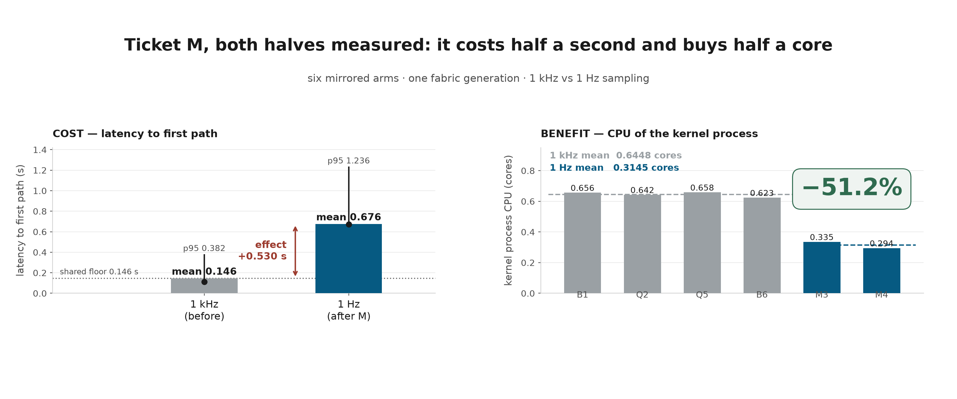
2 · WHAT THE EXPERIMENTS SAY
COST PRE-REGISTERED
effect +0.530 s, inside the registered 0.4–0.6 s band
BENEFIT POST-HOC
not registered before the data was read — an observation, not a result
10

Slide 11
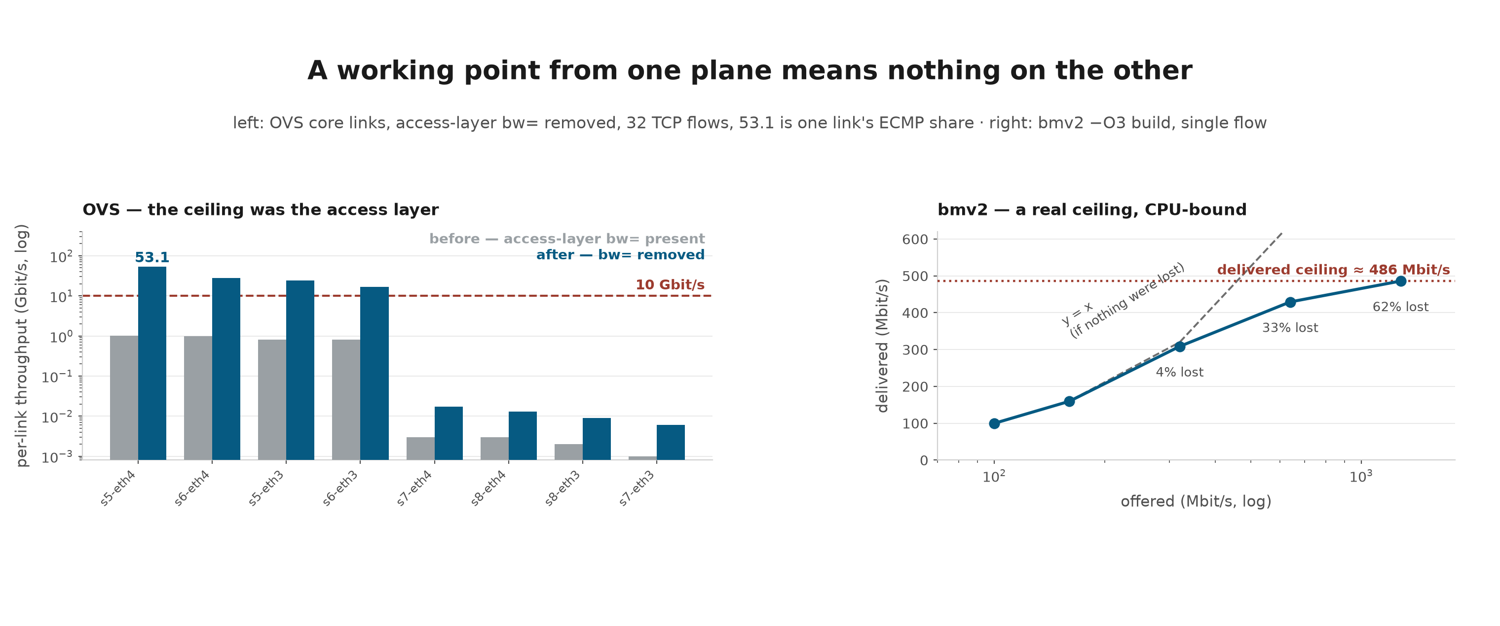
2 · WHAT THE EXPERIMENTS SAY
The ceiling was the access layer; BMv2's is real
THE FOUR SHORT BARS
ECMP hashed onto the top four — not a capacity floor
WHAT 53.1 IS
an interface-counter rate · 32 TCP flows · one link's ECMP share · host CPU 98.7%
11

Slide 12
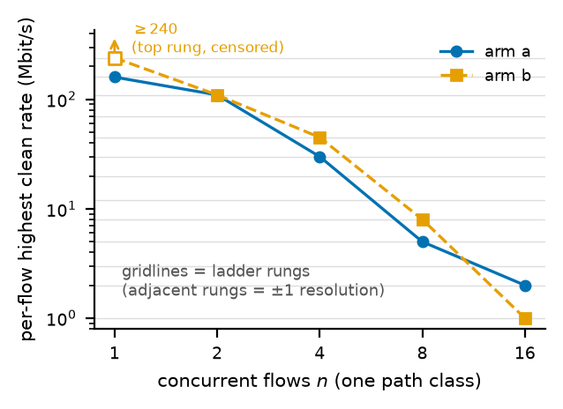
2 · WHAT THE EXPERIMENTS SAY
Capacity is a function of flow count
UDP
the ladder is iperf3 -u and “clean rate” is read from loss — this is a UDP claim
THE CONTROL
same path on TCP: T(16)/T(1) = 1.222 and 1.108 — no collapse
12

Slide 13
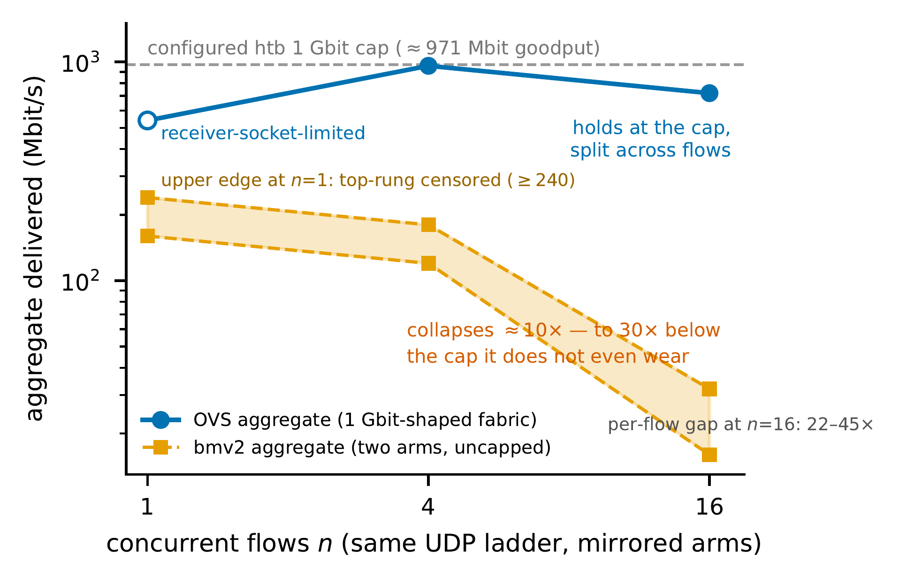
2 · WHAT THE EXPERIMENTS SAY
One plane holds its cap; the other collapses below it
UDP, BOTH PLANES
both ladders are iperf3 -u -l 1400 · with TCP the collapse does not appear
SO THE CLAIM IS
“UDP collapses ≈10×”, not “BMv2 collapses”
13

Slide 14
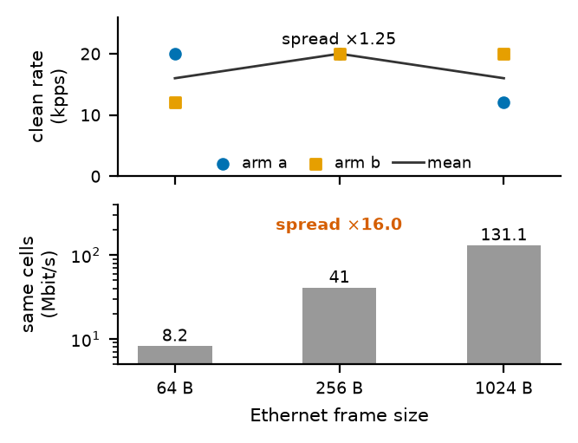
2 · WHAT THE EXPERIMENTS SAY
Same data, two units, sixteen times apart
THE AMBIGUITY
packet rate moves 1.25× while bit rate moves 16× — Mbit/s without a packet size is a 16× hole
14

Slide 15
2 · WHAT THE EXPERIMENTS SAY
18 PAPERS, AND WHAT THEY REPORT
12 of them measure BMv2 · counted, not estimated
reporting dimension | of the 12 | note
reports a throughput number | 10 / 12 | two measure latency only
states build flags | 0 / 12 | the variable worth 8× here
runs a build comparison | 0 / 12
names the BMv2 variant | 3 / 12 | all from one lab lineage
states the version | 1 / 12
sweeps packet size | 0 / 12
uses flow count as a variable | 0 / 12
THE GAP
the one variable we measured at 8× is the one none of them state — in our sample of 18
doc/2026-08-29_bmv2-performance-study.md §2-1 at b2cd6b5. Every negative is a statement about these 18 papers and the search boundary in §5-4 — not about the literature.
15

Slide 16
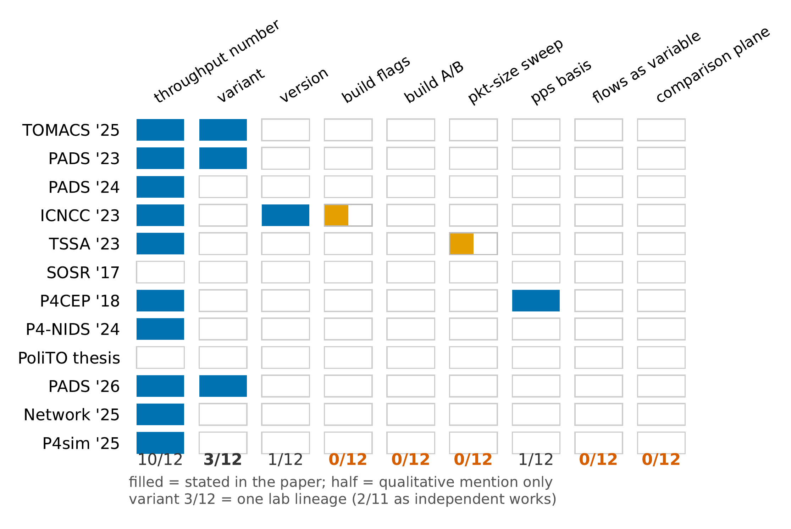
2 · WHAT THE EXPERIMENTS SAY
Twelve papers, nine reporting dimensions
THE GAPS ARE THE DATA
column totals are asserted against the survey table — a drift crashes the plot rather than drawing it
16

Slide 17
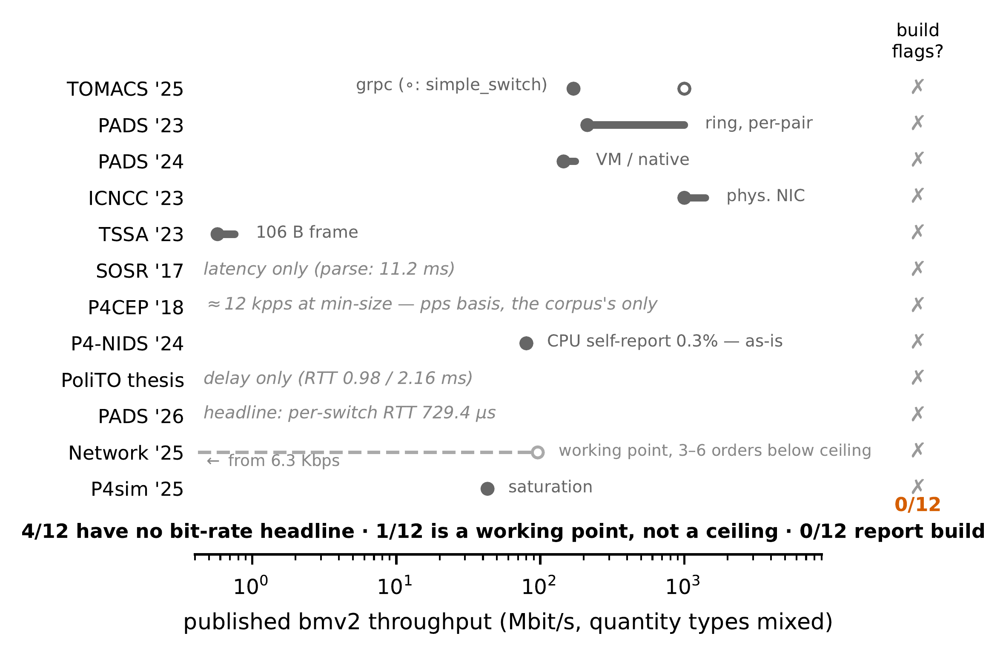
2 · WHAT THE EXPERIMENTS SAY
Twelve headline numbers, one axis
A THIRD CANNOT BE PLACED
4/12 publish no bit-rate headline · 1/12 is a working point, not a ceiling
NOTHING WAS CONVERTED
a packets-per-second headline stays in packets per second
17

Slide 18
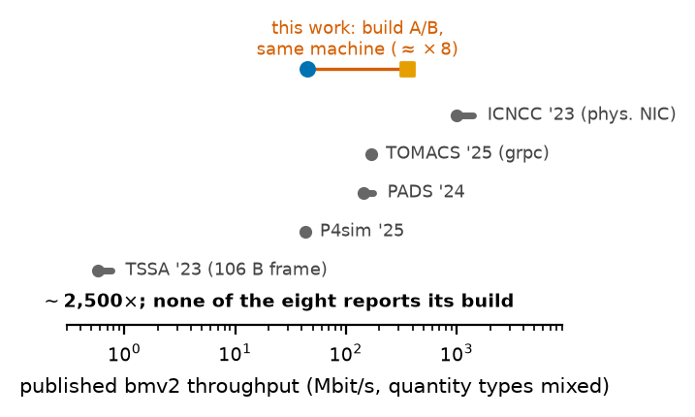
2 · WHAT THE EXPERIMENTS SAY
Self-reported throughputs span ~2,500×
FOR SCALE
~0.57 Mbit/s to ~1.4 Gbit/s · one build flag on one machine is worth 8× of that
18

Slide 19
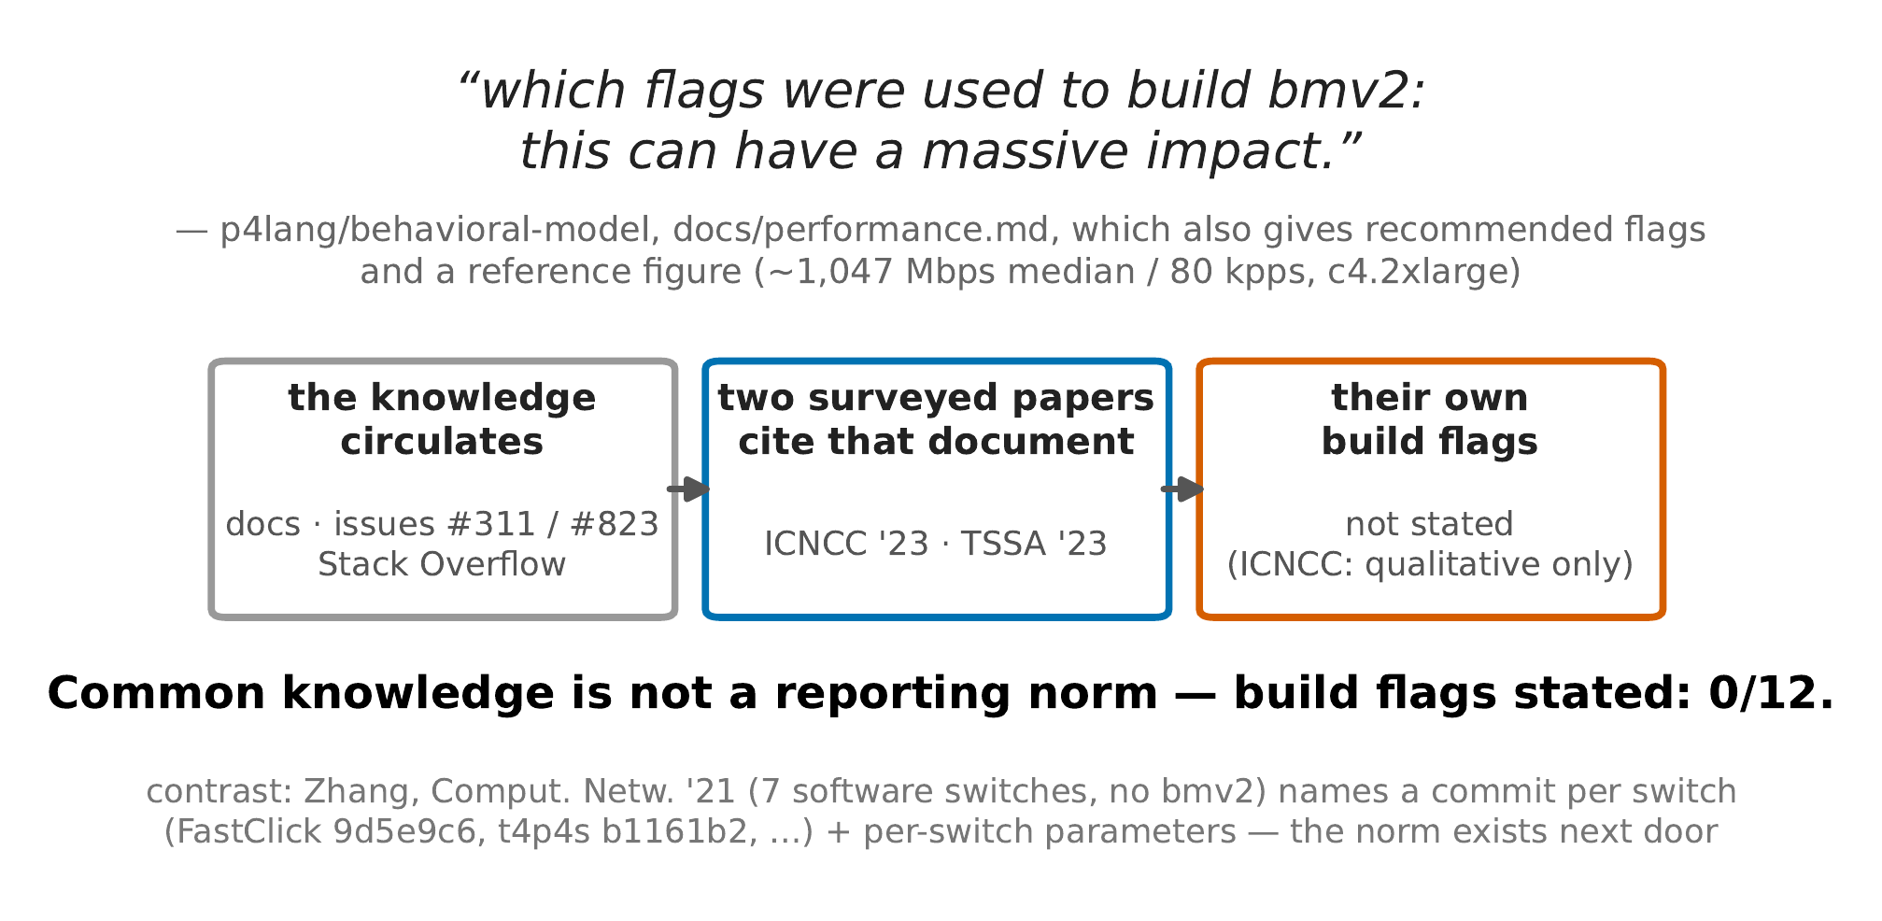
2 · WHAT THE EXPERIMENTS SAY
Known is not the same as reported
DESK CHECK
sources read, not re-measured · BMv2's own page says the debug build is slow, and two papers cite it
AND STILL
neither states its own build · build flags stated: 0/12
19

Slide 20
SECTION 3
Engineering, and what's next
The traffic round, a criterion that measured the wrong quantity, and what the next report will carry
20

Slide 21
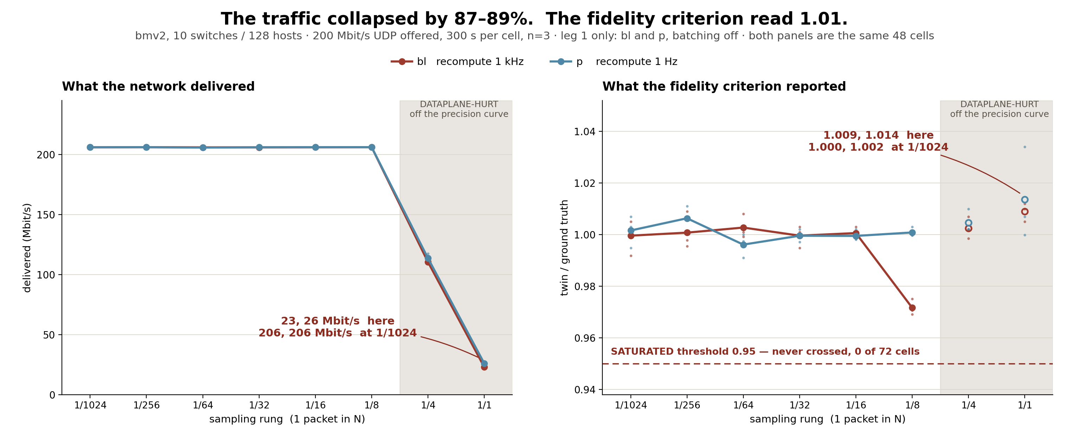
3 · ENGINEERING, AND WHAT'S NEXT
The criterion never measured the quantity its name says
NOT READ OUT
SATURATED fired 0 times in 72 cells · all four arms right-censored · indistinguishable, not equal
THE FLAT LINE MISLEADS
twin ÷ truth reads 1.009 at the rung that destroys 87–89% of the traffic
BATCHING NOT ESTIMABLE
batch on/off is aliased with leg and time of day — a confound, not noise
21

Slide 22
3 · ENGINEERING, AND WHAT'S NEXT
THE TRAFFIC ROUND
six arms · registered before any data
IT DISCRIMINATES
the flow endpoint went 8 → 12 under load and tracked the churn — the gate held on both arms
CONTRACT
39/39 against the live kernel, plus a 52-check self-test
THE 128-HOST EXAMPLE
the manual's own worked example passes as printed
THE HALF NOT ASKED
the timing question is unanswerable at 128 hosts — one sample costs 735 ms and needs 500
AND NOT BY SAMPLING HARDER
the instrument is slower than the thing it measures · answered at 4 hosts instead
PREREG 5cbd672, written before any data; kernel 1208d22, rebuild byte-identical. One sample = three endpoints, of which all_destination_paths is 699 ms and 931 KB.
22

Slide 23
3 · ENGINEERING, AND WHAT'S NEXT
MEASURED
ONE FLAG, TWO MEANINGS
a decision and an observation, sharing one bit
WHO WRITES is_up
WHAT IT COST, MEASURED
THE POWER API
8–13 s
of “on” after the machine was commanded off — the liveness cache writes it back within 0.3–1.5 s. 18/18 across both arms
a decision — I commanded it off
THE 1 Hz LIVENESS WORKER
an observation — it answers
OFF vs ON
two switches equally dead: the commanded one reads OFF, the crashed one reads ON. The endpoint reports the order, not the state
One bit cannot tell “the wall switch is off” from “the bulb burned out”.
never fires
the three-state check for “something died that should not have” reads the same bit on both sides
RULED
split into admin_state (the command) and reachable (the probe) · is_up stays as an alias for reachable
Decided, not shipped: the fix is dispatched and not yet on trunk.
Live two-arm run, 9 each, at 7e8d91e0 (merged 85c1a159); raw at audit-raw 19e3ab88. Ruling recorded at b57736cd.
23

Slide 24
3 · ENGINEERING, AND WHAT'S NEXT
MEASURED
WHAT THE NIGHT ROUND FOUND
six endpoints · what they report vs what the switch does
A LINK COMES BACK
a link declared down through the API is silently restored by the 30 s topology poll — 21.5–25.4 s. A real cut never restores itself
SHUTDOWN KEEPS WRITING
“All subsystems stopped. Exiting.” is printed, and 10.7 s of southbound writes follow it — no log line mentions them
A COUNTER COUNTS POSTS
20 installs of one match: succeeded +20, the switch +1 · 15 deletes of a match that is not there: succeeded +15, the switch +0
A 200 THAT INSTALLED NOTHING
two reserved group ids answer “200 installed” and never appear in groupdesc · the delete branch of the same code answers 404 honestly
A METRIC THAT NEVER MOVES
path switch_count is computed from the static model: identical across 12 paths with 8 of 40 switch-to-switch edges down
40× FOR THE SAME WRITE
meter install 1024 ms against group install 20 ms — both are one OpenFlow write, measured at the client
Current behaviour only — the fixes were still running when these were taken.
Kernel cca5e3e4, helper 6685d3a9; trunk 4088b237 / f943de8f by round. Figures and raw logs in figures/overnight-0904/. The shutdown baseline (~2.4 s idle) is read from another round, on another binary, and is marked as such.
24

Slide 25
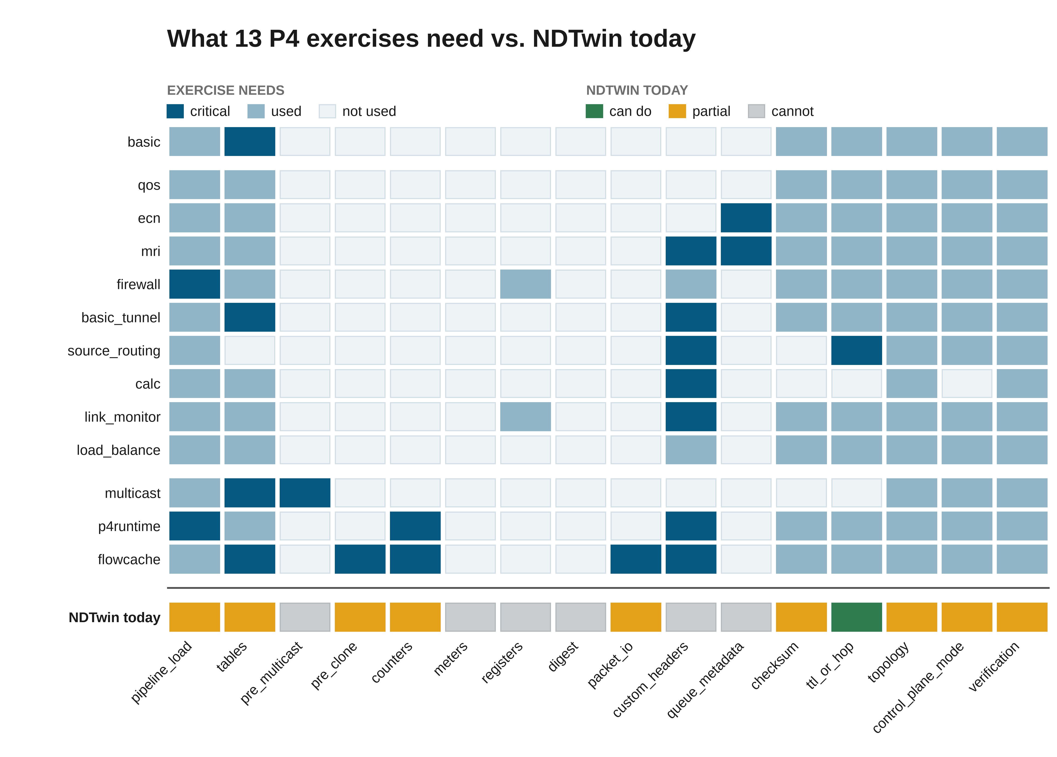
3 · ENGINEERING, AND WHAT'S NEXT
READ-CODE / NOT RUN
What the tutorials ask for
13 exercises · 16 capability dimensions · read, not run
PIPELINE LOAD, NOT FEATURES
8 of the 13 want one thing: load the .p4 they ship with · 6 of the 16 dimensions only ask whether NDTwin's own program has a feature
EXACT + LPM ONLY · 1/13 UNCHANGED
0/13 need meters or digest · only basic runs as-is, and even then the skeleton punts where the exercise drops
25

Slide 26
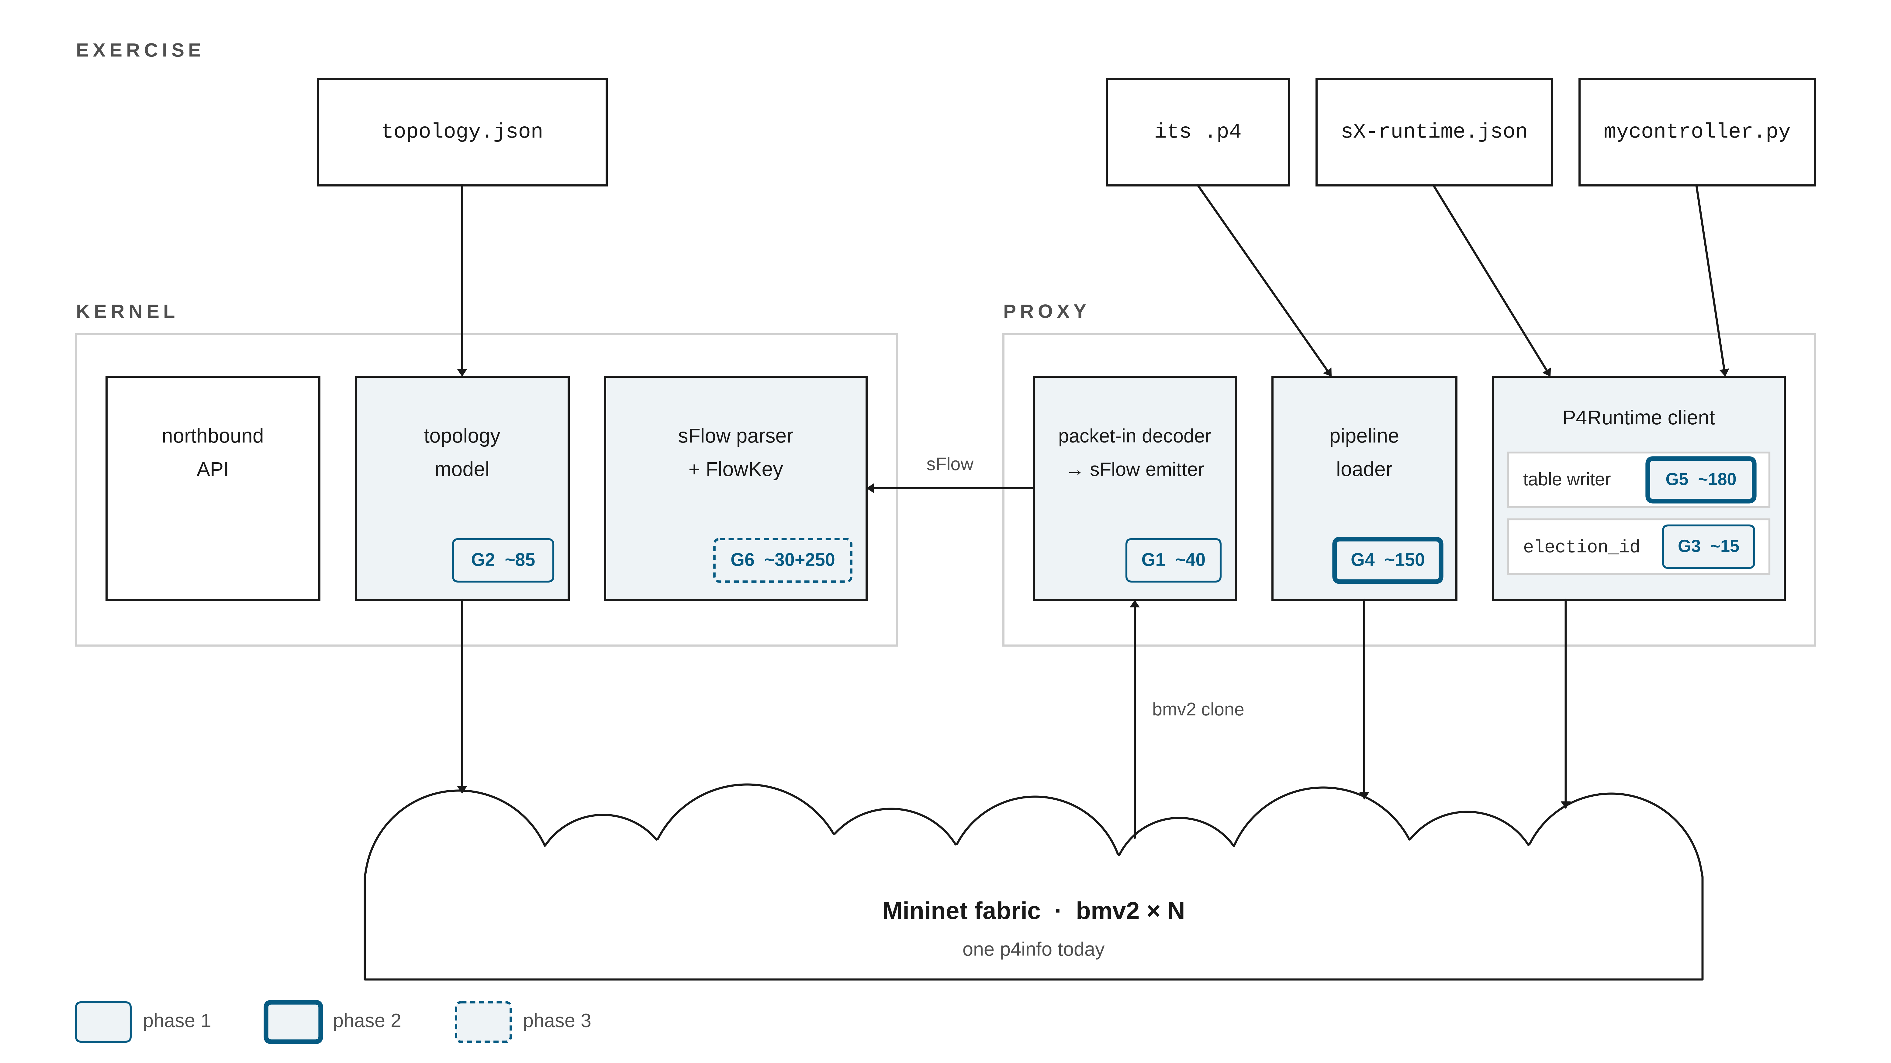
3 · ENGINEERING, AND WHAT'S NEXT
READ-CODE / NOT RUN
Where the five gaps live
proxy side and kernel side · sizes are estimates
NOT ONE LINE WRITTEN
the badges are estimated sizes, not progress · border style is the phase, and phase three is the sFlow parser
Read at trunk 1a284f75 · exercises run 09-08 on their own harness. Line counts estimated in GAP-ANALYSIS §1/§3.
26

Slide 27
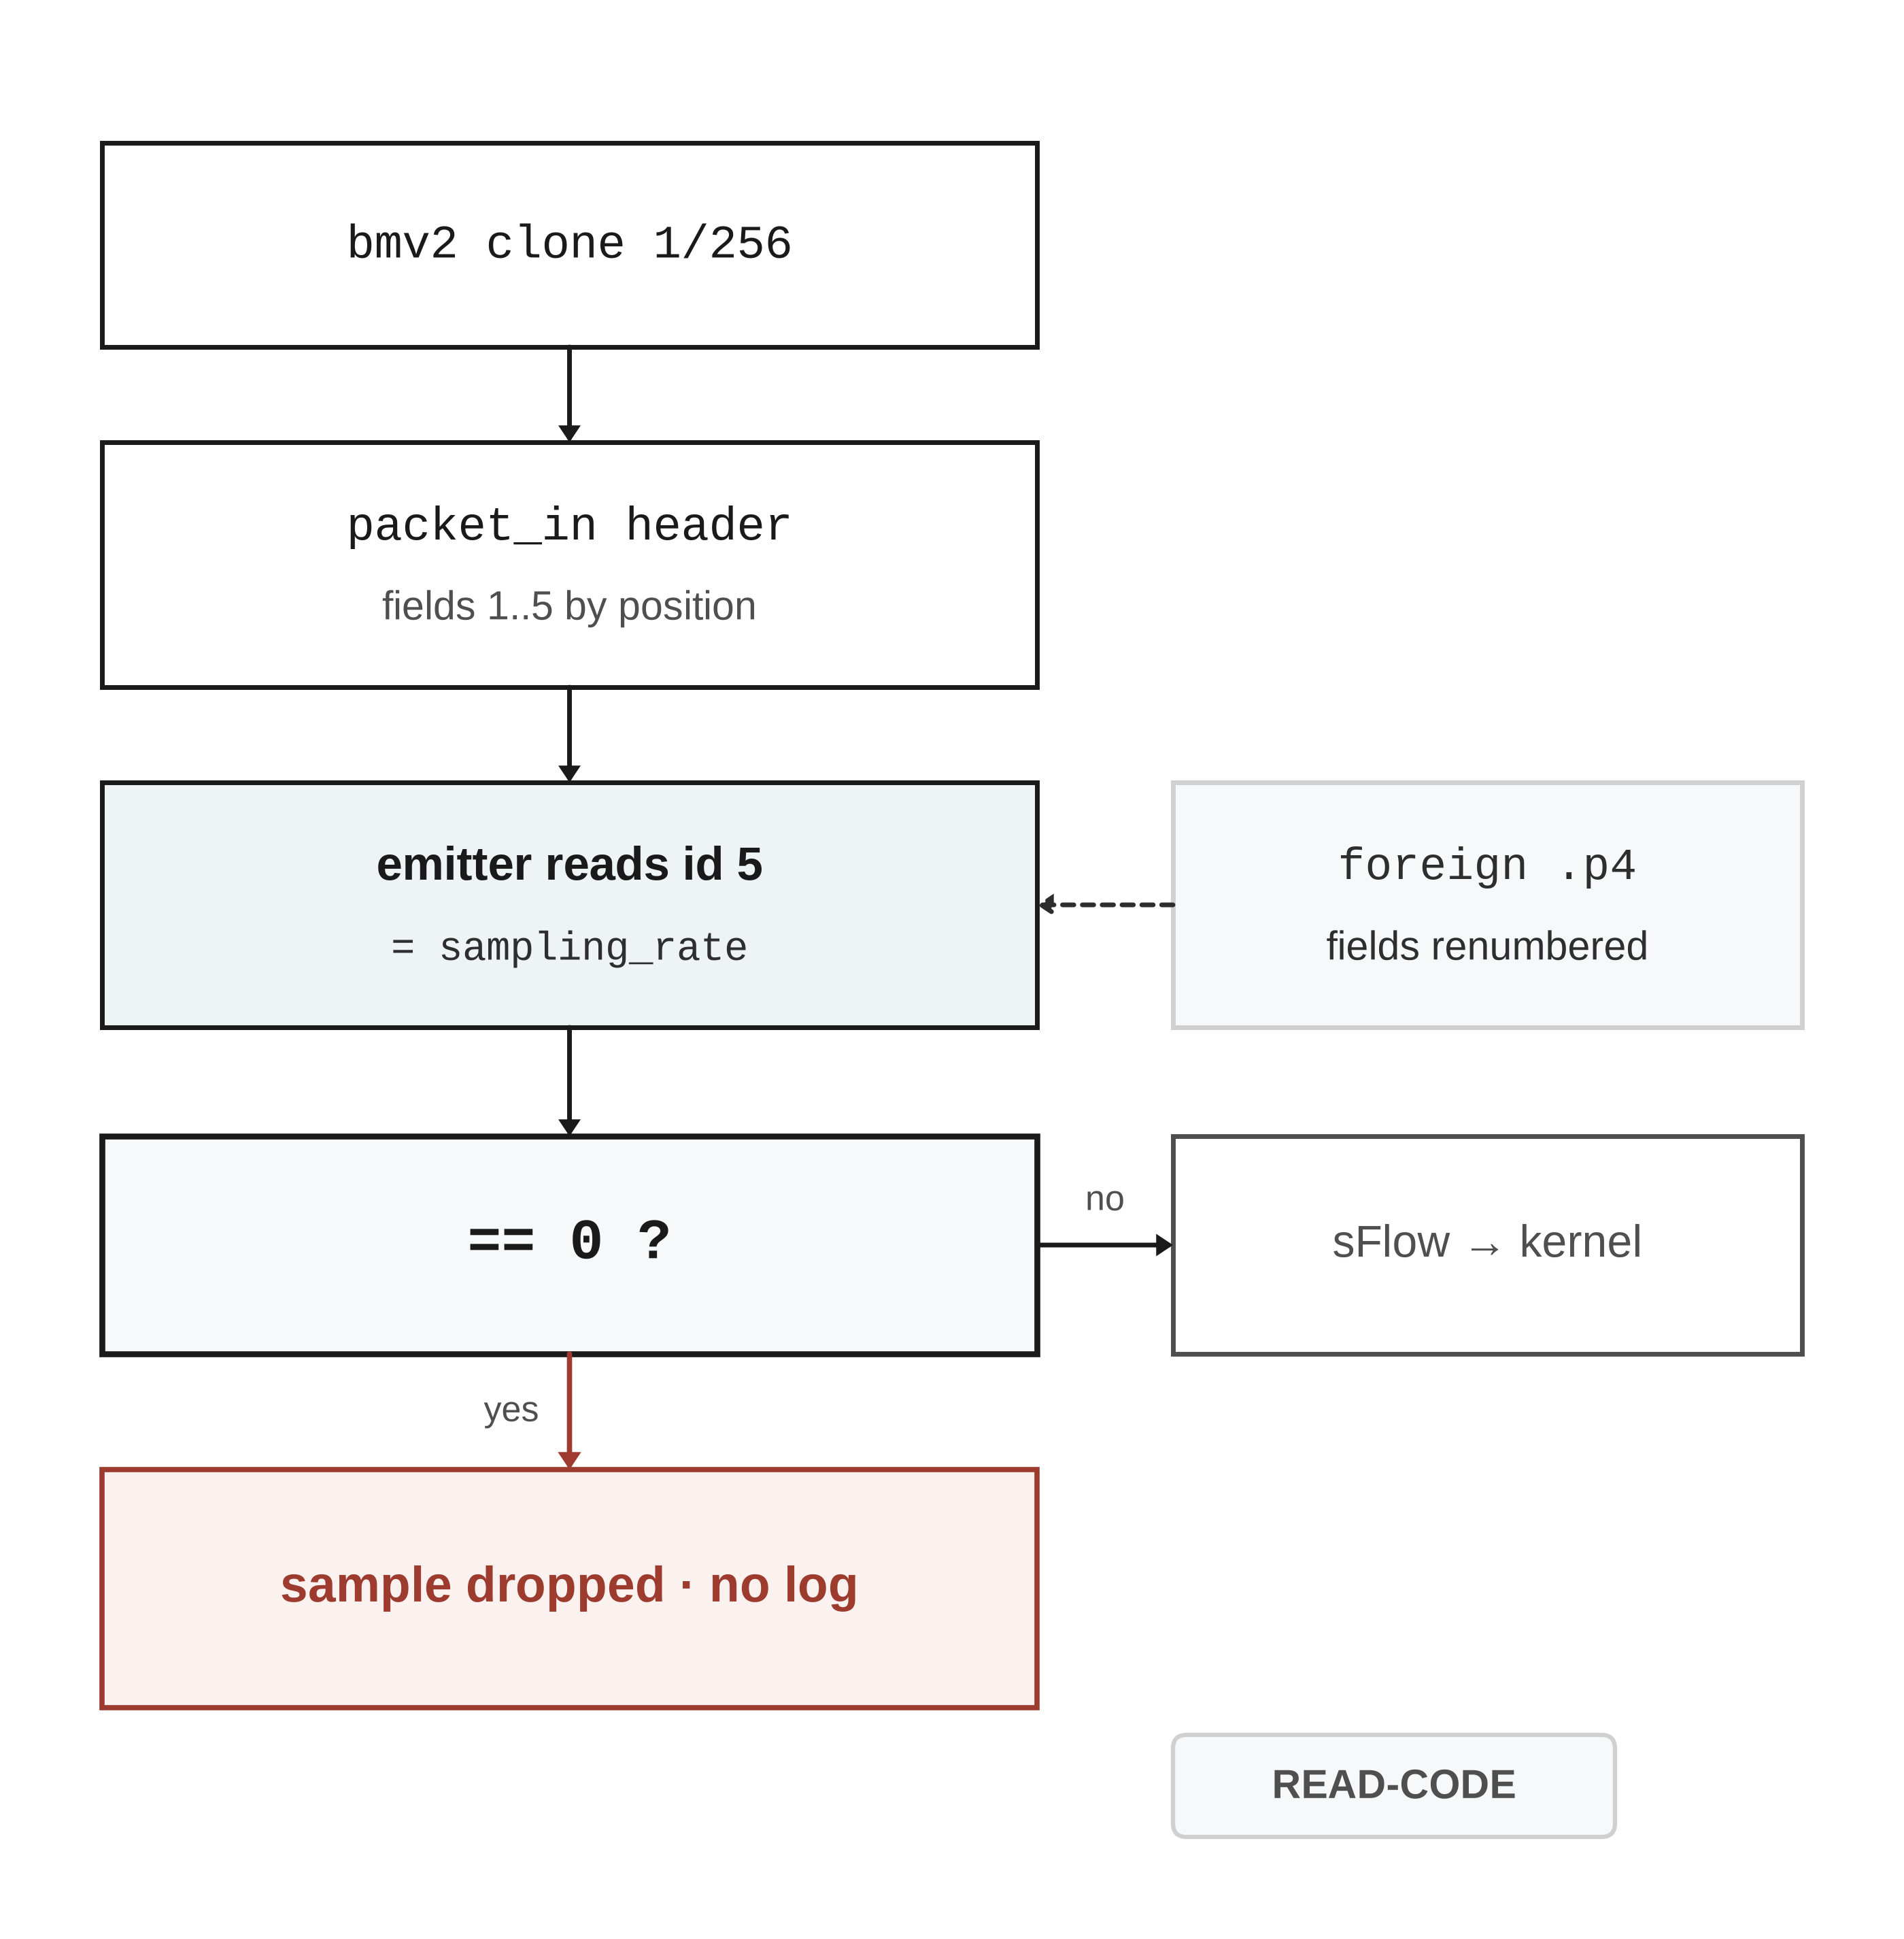
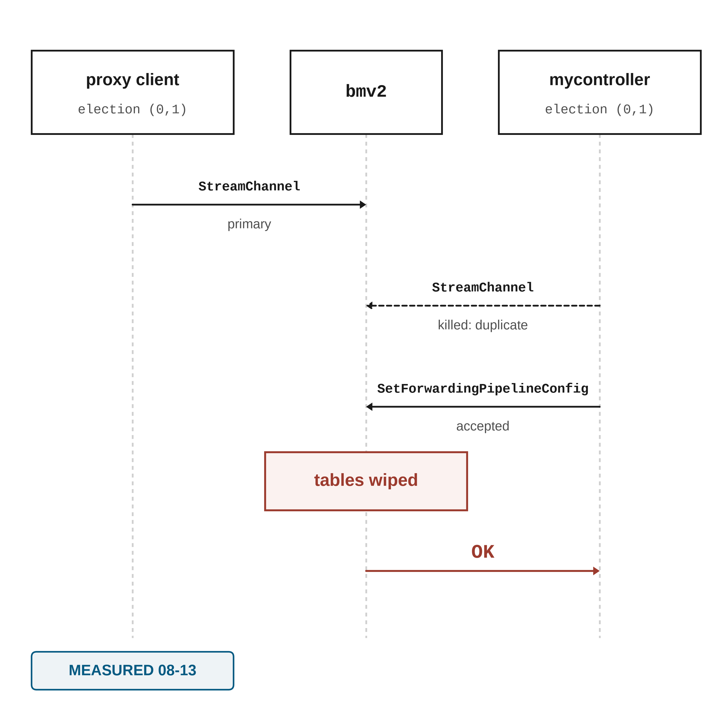
3 · ENGINEERING, AND WHAT'S NEXT
WHAT ONLY A FOREIGN P4 PROGRAM REVEALS
the same p4info on ten switches, for months
① fields read by position
② two controllers, one switch
① line-checked at sflow_emitter.py:425-429,468-470 and p4_client.py:217,222 — the mechanism, not an observation. ② measured 2026-08-13; bmv2 follows the spec throughout.
27

Slide 28
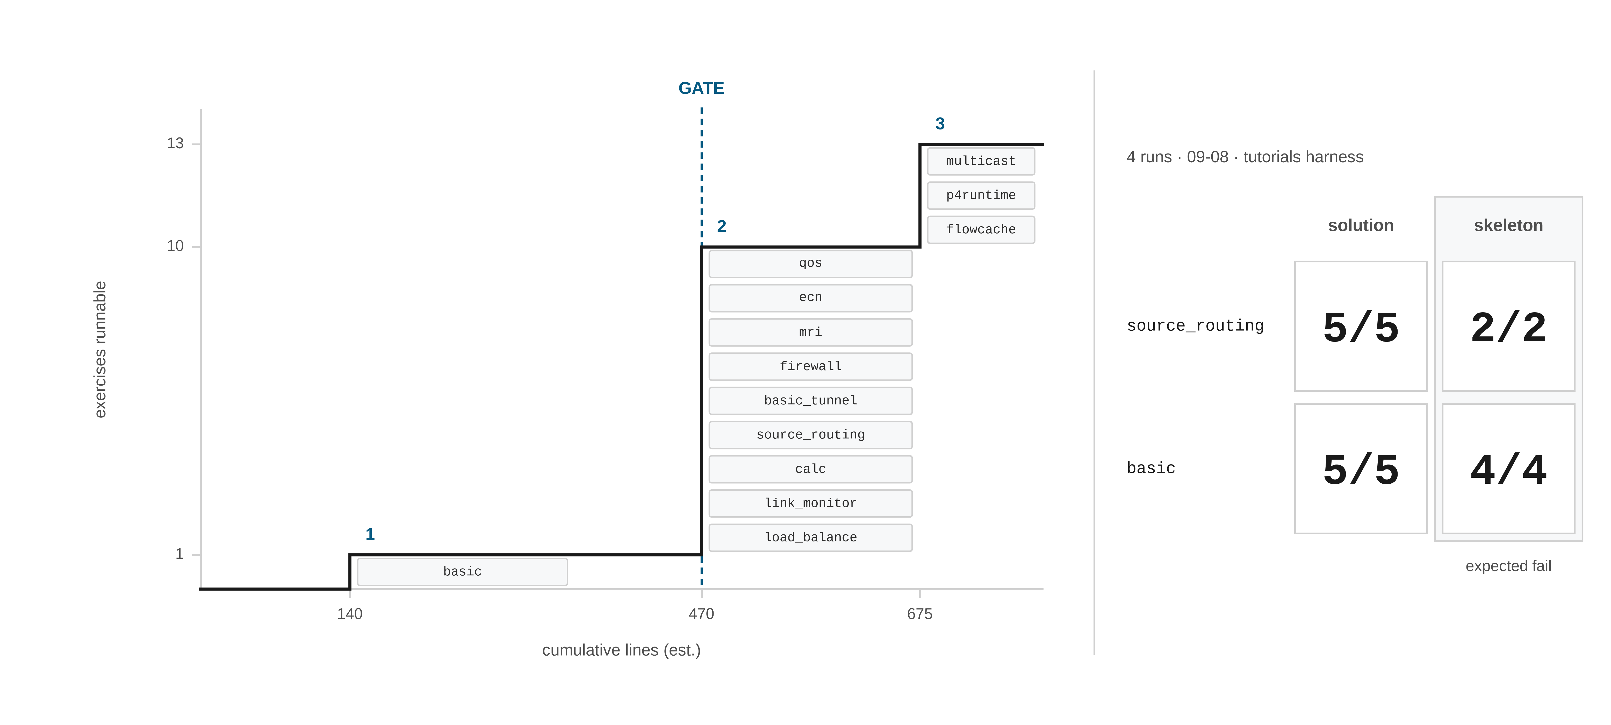
3 · ENGINEERING, AND WHAT'S NEXT
MIXED — SEE CHIPS
Three phases to a regression gate
~675 lines · the gate opens after phase two
0 OF 13 ON NDTWIN
the 2×2 ran on the tutorials' own harness with their switch binary — it shows the exercises behave as expected, not that NDTwin can host them
WHY THE SKELETONS
an expected failure, observed · a gate nobody has seen go red is not a gate
Line counts estimated in GAP-ANALYSIS §6. Runs 09-08 with /usr/local/bin/simple_switch_grpc (327fa7d1), not the NDTwin build.
28

Slide 29
3 · ENGINEERING, AND WHAT'S NEXT
WORTH WRITING UP?
asking, not arguing
QUESTION
Has anyone quantified what an unstated build flag costs?
MEASURED
one build flag · 8.0× on a single hop · 12× across three
MEASURED
unit ambiguity adds 16× on the same data
SURVEYED
0/12 state that flag, in our sample of 18
DESK CHECK
so a ~2,500× spread has no attributable cause — from reading, not measured
THE QUESTION
we did not find anyone who has done this · a pointer would be the useful answer
Not that this is unknown — that being known has not made it reported.
29

Slide 30
PLANNED FOR THE NEXT REPORT
three, each with the test that settles it
1
2
3
Measure the ceiling with a criterion that can see it
Finish the third question on its own terms
Close the manual line to publishable grade
SATURATED never fired in 72 cells, so the arms cannot be told apart.
The fast build's install and provenance are verified. The functional suite is not.
Install, whole-stack and API page are green. Four executable pages remain.
Done when a registered criterion reads out a rung the data plane actually fails at.
Done when the whole L0–L4 suite passes on the fast build.
Done when every executable page has been executed.
Same shape as the 20 and 27 August pages, so the next report can be checked against this one.
30

Slide 31
WHERE IT STANDS
settled · open
SETTLED
OPEN
The manual installs
clean room · 12/12 up
The sampling ceiling
measured fidelity, not the wall
The API page
29/29 correct
Fast build as default
L0–L4 has not run
One build flag
8.0× · 12× across three hops
Manual, remaining
four executable pages
Units
1.25× or 16×, by choice of unit
The boot ring
arms never taken to 6–8
Capacity
a function of flow count (UDP)
Batching
aliased with time of day
The survey
0/12 state build flags
Undocumented routes
twelve · one used by the GUI
Marked items are what the next report answers.
31

